Slide 1
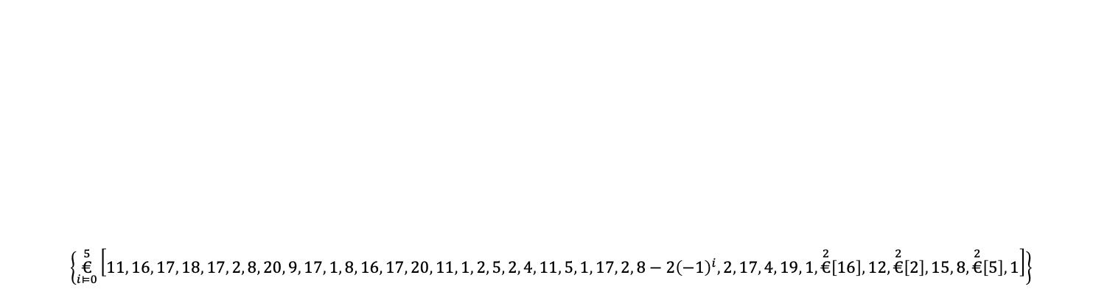
$$\left\{\overset{5}{\underset{i⊨0}{€}}\left[11 , 16 , 17 , 18 , 17 , 2 , 8 , 20 , 9 , 17 , 1 , 8 , 16 , 17 , 20 , 11 , 1 , 2 , 5 , 2 , 4 , 11 , 5 , 1 , 17 , 2 , 8−2⁢{\left(−1\right)}^{i} , 2 , 17 , 4 , 19 , 1 , \overset{2}{€}\left[16\right] , 12 , \overset{2}{€}\left[2\right] , 15 , 8 , \overset{2}{€}\left[5\right] , 1\right]\right\}$$

